Slide 1

Creating Efficiency through Automation.
Working in the Electronics, Industrial and Healthcare Industries

Slide 2
Global Corporate Account Teams.
Goals for Getech
  Exclusive or Protected status within the customer environment
  Early stage inclusion in customer technology and process development
  Predictable manufacturing load and service demands
  Predictable cash management
  Regional price control through central agreements
Goals for Customer
  Preferential Terms
  Preferential Pricing
  Quick turn additive capacity
  Access to specialized external engineering resources
  Predictable/Flexible cash management

Slide 3
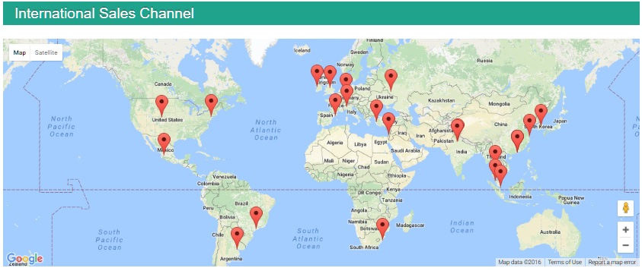
Global Worldwide Customers
Today: Jabil, Flex, Sanmina, Micron Semiconductor, Continental, Valeo,Honeywell
Potential: Oppo,

Slide 4
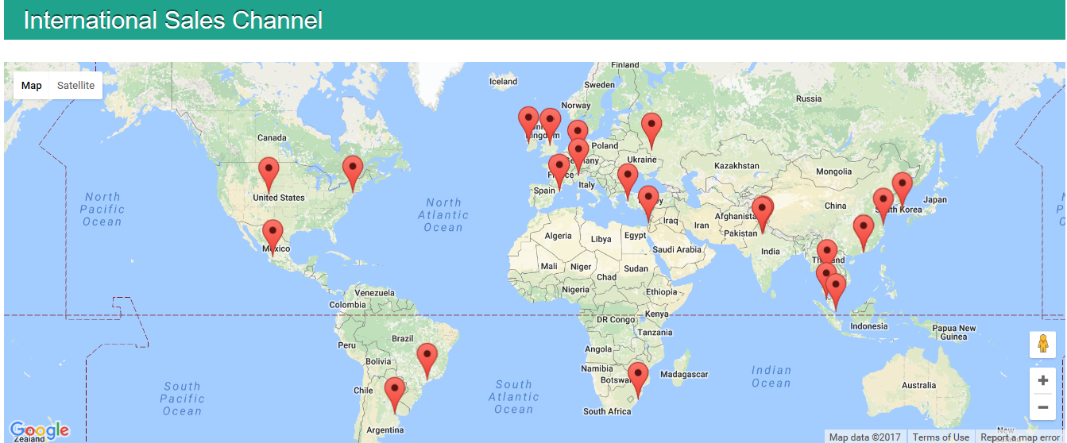
Getech General Sales Structure.
GETECH AUTOMATION
Primary commercial Relationship is with Distributors
Commercial
Ts and Cs, Pricing
Technical Specifications and Support agreements
Global Account
Distributors
Tech Support, New Product Development and volume negotiations
SITE
SITE
SITE
SITE
SITE
National Accounts
National Accounts
National Accounts
National Accounts
SITE
SITE

Slide 5

Global Corporate Account Structure
Commercial
Ts and Cs, Pricing
Regional commercial relationship is with distributors
Regional commercial relationship is with Getech
Regional agreement on local support
Tech Support, New Product Development and volume negotiations
Technical Specifications and Support agreements
Global Account

Slide 6
Global Corporate Account Structure
Regional commercial relationship is with distributors
Commercial
Ts and Cs, Pricing
Regional commercial relationship is with Getech
Regional agreement on local support
Tech Support, New Product Development and volume negotiations
Technical Specifications and Support agreements
Regional Managment
Account
Owner
Global Account

Slide 7
Global Corporate Account Structure
Keep it simple
Document and contract – Formalize.
Know the customer corporate objectives
Address the corporate objectives centrally
Act with local organizations for support and account localized needs.
Create metrics and reports
Communicate success and failure to all parties.
Learn or Leverage.

Slide 8
Who and What Accounts
Account | Owner | Agrmt. Headquarters
Valeo | Allen | France
Sanmina | Allen | USA
Jabil | David | Malaysia
Micron | Srinivas | Singapore
Honeywell | Allen | USA
Flex | James | China
Continental | David | Philippines/Germany

Slide 9
Roles and Responsibilities
Criteria | Account Owner | Regional Manager
Pricing | Negotiate and confirm | Communicate and uphold
Terms | Negotiate and confirm | Communicate and uphold
Machine Developments | Based on original facility location and demand. Collaboration lead by Acct owner.
Support Structure | Negotiate and confirm | Adapt as required by site demands
Escalation issues | Manage all escalations and report on resolutions. | Report any issue that may impact the agreements stability

Slide 10
Remuneration
Account Owner: 15%
PO issues from: 15%
Machines Delivered to: 70%

