Slide 1
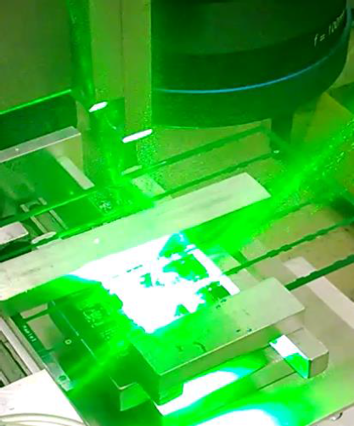
Introduction to Laser Depaneling

Slide 2
Different PCB Depaneling Methods
Contact method
Non-contact method
Breaking by hand
Pizza cutter
Punching
Mechanical routing
Sawing
Laser
Advantages
Zero mechanical stress
Zero tool wear
Fine cut width
Disadvantages
Not for thick PCBs
Not the fastest
Not the cheapest

Slide 3
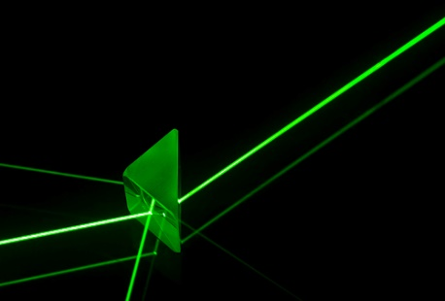
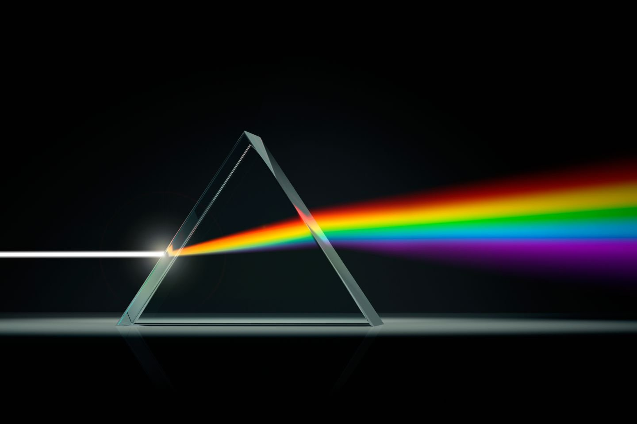
What is laser?
Light Amplification by Stimulated Emission of Radiation
It is simply light with some unique properties
Laser
Artificial
Mono-chromatic
Coherent
Ordinary visible light
Natural and artificial
Poly-chromatic
Not coherent
©mattbell
Notes:
Monochromatic – single wavelength
Coherent – temporally and spatially in-phase, imagine a marching band, every row is the same instance in time, every column is same location in space

Slide 4
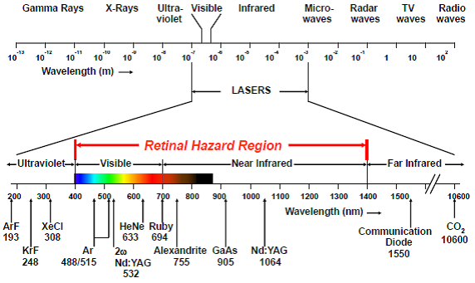
Light is a form of electro-magnetic radiation
So are gamma rays, X-rays, UV rays, IR rays, microwaves and radio waves
The difference lies in the wavelength
There are many lasers that are not visible by the naked eye
Notes:
CO2 is 10600nm, green is 532nm

Slide 5
How is laser generated? – Basic concept 1
Pump energy
Rear mirror
Output coupler
Pumping
Active medium
Pump energy
Rear mirror
Output coupler
Population inversion
Active medium
Excited atom
Unexcited atom
Notes:
Pumping – inputs energy
Population inversion – more excited particles than non-excited particles

Slide 6
How is laser generated? – Basic concept 2
Pump energy
Rear mirror
Output coupler
Laser beam
output
Stimulated emission
Active medium
Pump energy
Rear mirror
Output coupler
Laser beam
output
Amplification
Active medium
Excited atom
Unexcited atom
Notes:
Stimulated emission – triggering photon stimulates the excited particles to emit the same wavelength photon
Amplification – internal reflection reinforces the stimulated emission and total output is amplified

Slide 7


Slide 8
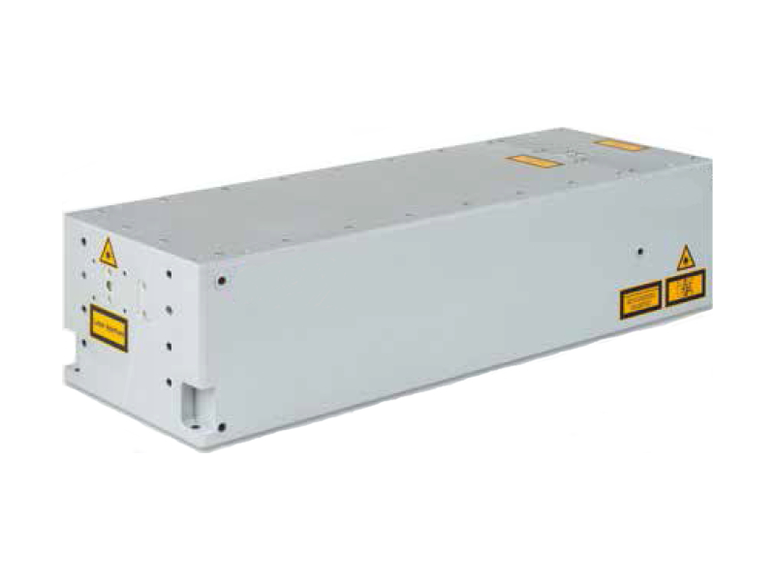
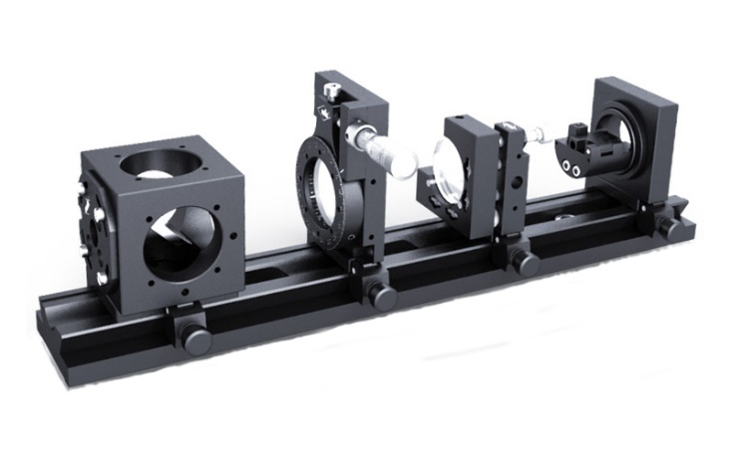
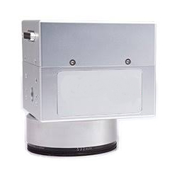
What do you need in order to cut with laser?
Beam manipulation optics
Focusing optics (including positioning)
Laser source
This is where the laser comes from
This is what makes the laser ‘bend’ to our will
This is what cuts your PCBs
*Note: Getech does not manufacture laser sources and optics

Slide 9

How does laser cut PCB? – Basic 1
Focusing the laser to a very small spot to intensify the power
Cutting is only possible at the focused position where intensity is the highest
Raw beam
Focusing
Focused position
This is science fiction

Slide 10
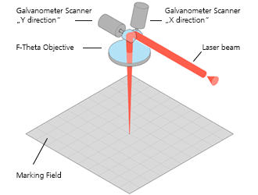
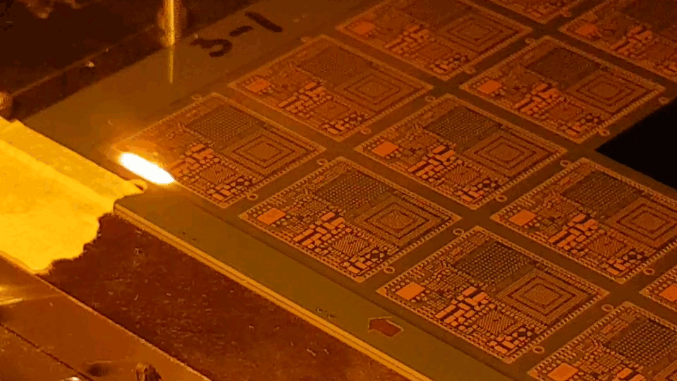
How does laser cut PCB? – Basic 2
Galvanometric scanner runs the laser beam across the panel
Laser cutting in progress
Mirrors deflect laser to cut at desired spot
https://www.raylase.de/en/products/2-axis-deflection-unit.html

Slide 11
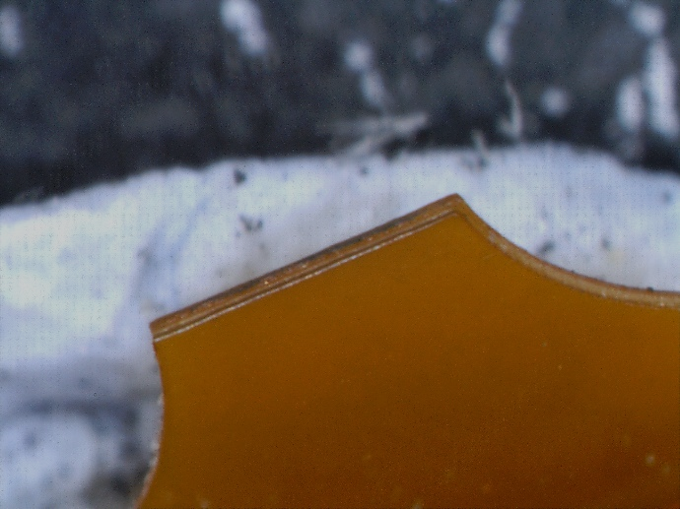
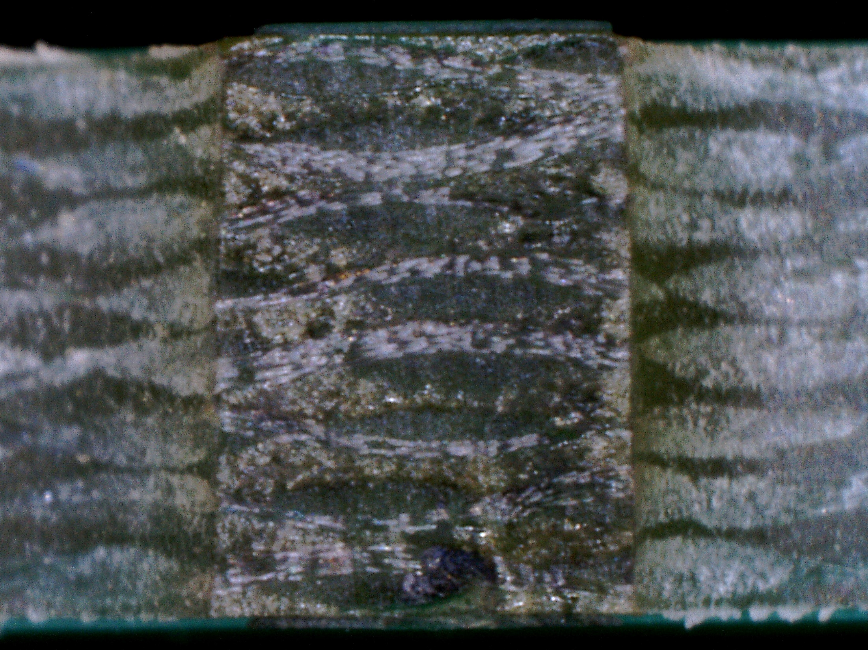
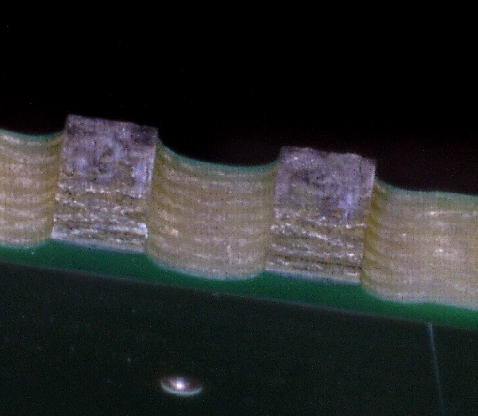
How does laser cut PCB? – Basic 3
Ablates a few microns to tens of microns deep per pass
The thicker the panel, the more passes it takes
0.1mm thick polyimide
10 passes to cut through
1.6mm thick PCB
180 passes to cut through
Cut edges
1.6mm
Cut edge
500 µm
250 µm

Slide 12
What is ablation?
The process of removing material from a substrate using a laser beam
Photon energy
Direct bond breaking
Photochemical
Material excitation
Thermal + non-thermal excitations
Mixed
Ablation
Plasma formation
Laser
Temperature rise
Photothermal
Bäuerle. (2000). Laser Processing and Chemistry. Berlin, Heidelberg: Springer-Verlag
Notes:
Most of the time is a mix of both, the difference in physical effect is just due to the difference in proportion of the individual mechanism
It is not easy to obtain pure thermal or pure chemical phenomenon in typical industrial applications, and it is probably pointless to try to achieve that. It makes it less robust

Slide 13
Photothermal or photochemical?
Green laser photon
2.33eV (≈3.73x10⁻¹⁹ J)
More photochemical
Less photothermal
CO₂ laser photon
0.12eV (≈1.87x10⁻²⁰ J)
More photothermal
Less photochemical
193nm UV
266nm UV
355nm UV
Green
Nd:YAG
CO₂
C – O
N – N
C – N
N – O
C – C
O – O
H – H
O – H
C – H
N – H
Lasers
Thermal
Photochemical
Common diatomic single bonds
Yu-Ran, Luo. (2007). Comprehensive Handbook of Chemical Bond Energies. Boca Raton, FL: Taylor & Francis Group
Notes:
This is a comparison against single bonds for reference only. Most of the time, molecules consist of more than just single bonds between single atoms, there will be double or triple bonds between multiple atoms, so even with UV laser it does not mean it is 100% pure bond breaking. It just means it is that much more likely for bond breaking to take place than non-bond breaking to occur using the UV laser. Similarly, the green cannot break many types of bonds, but there will still be some bonds that it can break. On top of that, there is the phenomenon of multi-photon absorption that allows even CO2 laser to break bonds. It is simply not as efficient as UV laser is bond breaking

Slide 14
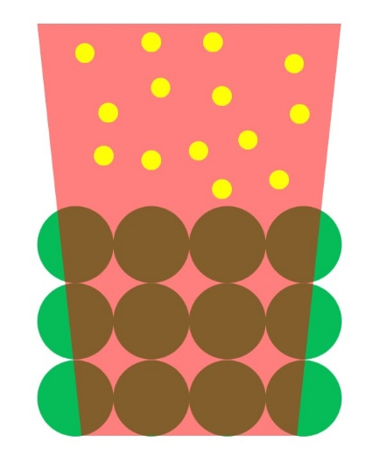
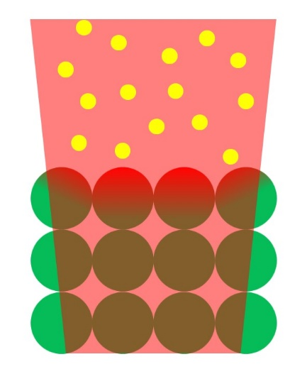
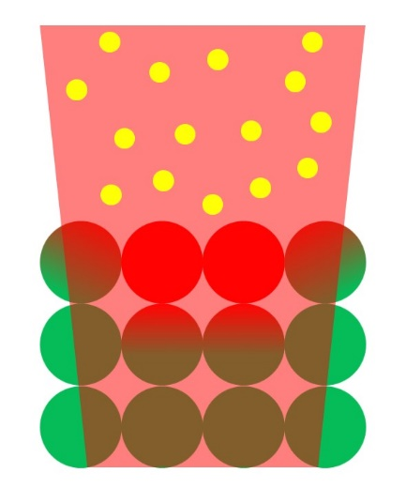
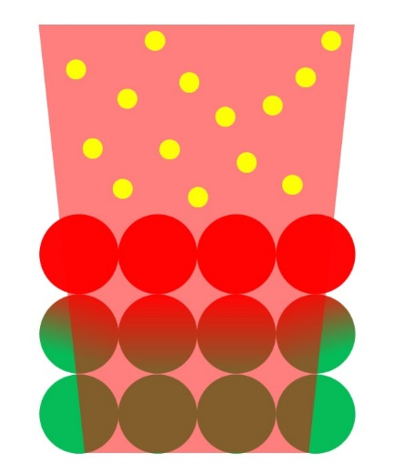
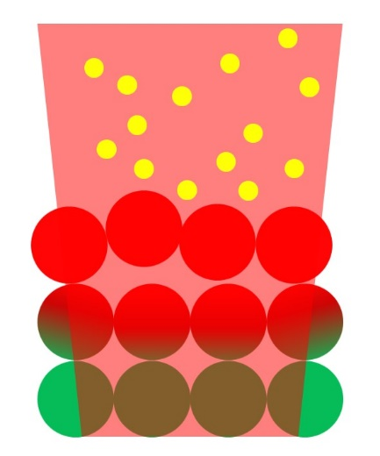
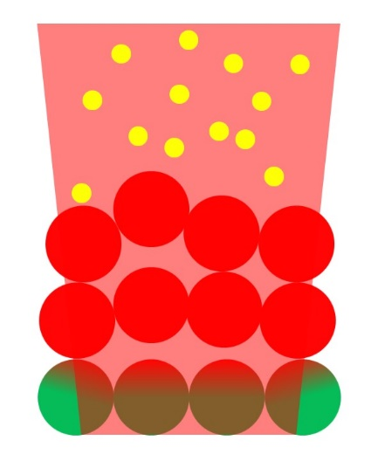
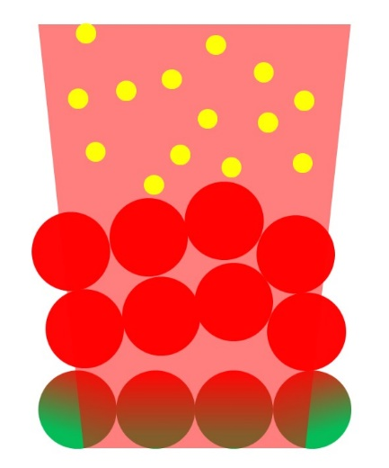
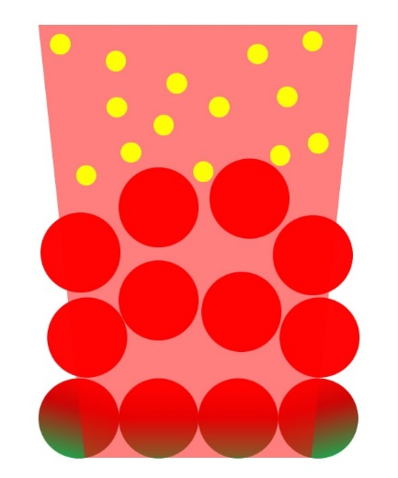
Photothermal excitation
1
2
3
4
5
6
7
8
Photon
Fully excited
Partially excited
Not excited
Notes:
The particles need to become sufficiently excited to be able to break away from the bulk lattice structure, and this usually does not happen before they have transferred energy to neighbouring particles as well

Slide 15
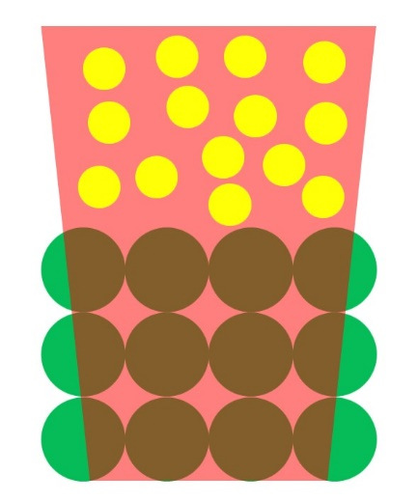
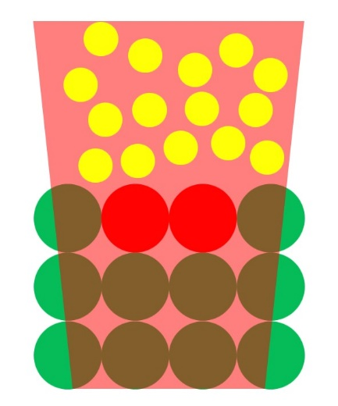
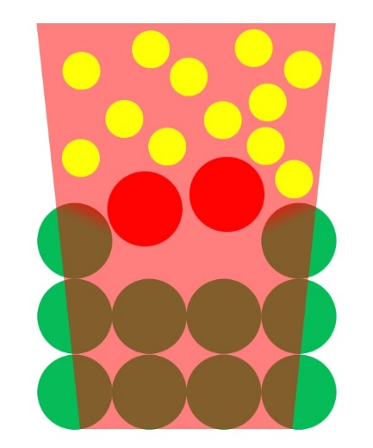
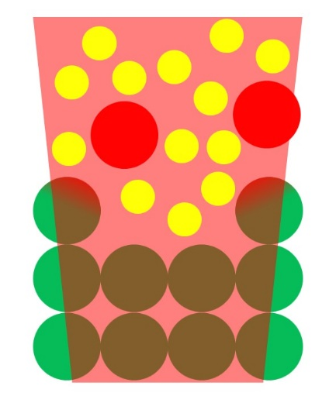
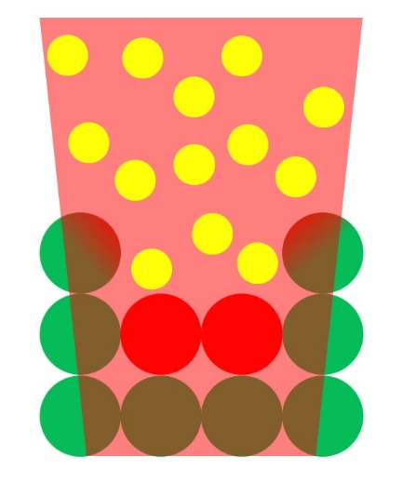
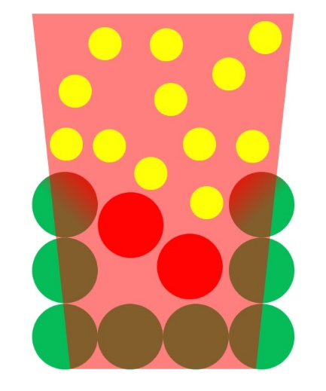
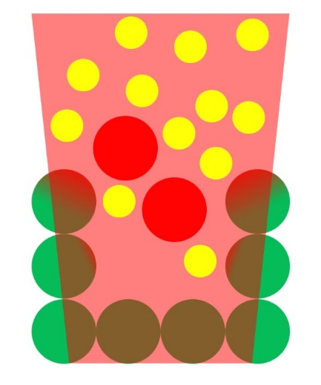
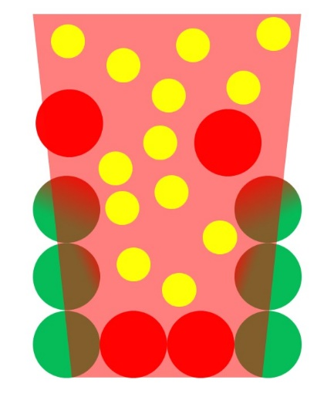
Photochemical excitation
1
2
3
4
5
6
7
8
Photon
Fully excited
Partially excited
Not excited
Notes:
Once the particles receive the energy, they are directly energised enough to break away. Thus, there is minimal transfer of energy to the neighbouring particles. There will be little energy transfer to the bulk and so will have little damage. This is what constitutes cold ablation. But this phenomenon does not occur purely because it is UV laser. Sufficiently short duration is also needed to ensure there is no secondary excitation. But such ablation is not fast as it is literally layer by layer removal of molecules, therefore practical industrial machining cannot rely purely on such phenomenon.

Slide 16
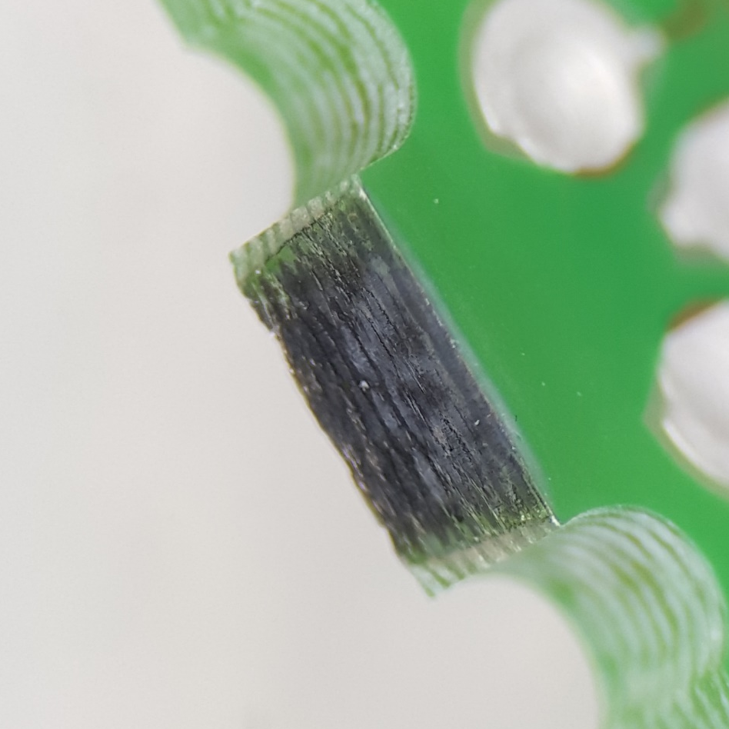
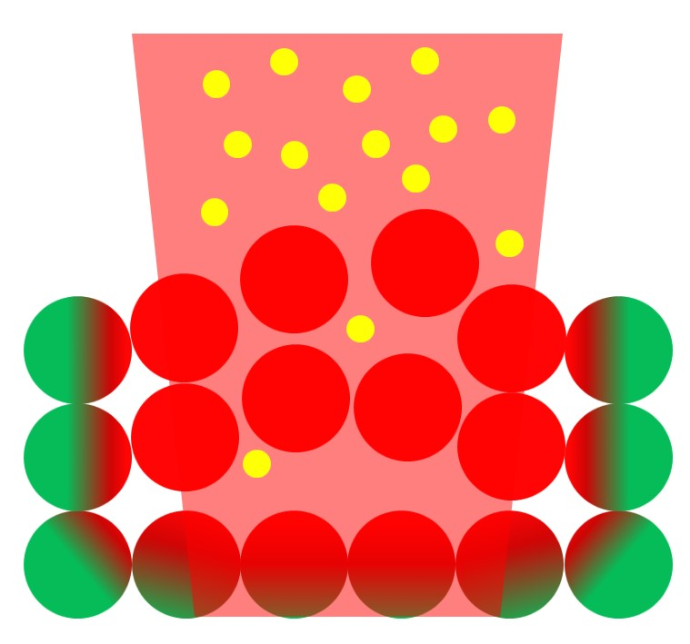
What about charring?
It is a result of heat accumulation in the material that is directly beside those being ablated
Charring here
Charring here
Char residue is left on the surface of the side that is not cut
Photon
Fully excited
Partially excited
Not excited

Slide 17
Why does it happen?
Heat accumulates because the material is unable to conduct the heat away from the cutting site faster than it receives
SS 310
E-glass
Epoxy resin
FR4
≈3.41x10⁻⁷
http://www.matweb.com/index.aspx
Notes:
The material, FR4, comprises of glass fibers and epoxy resin. Epoxy resin will char if left to sufficient heat. Basically, the energy is not enough to vaporise as it is not directly exposed to the laser beam. But because it cannot conduct it away fast enough, it is left there to be slowly cooked to decomposition temperature. At this temperature, the epoxy resin breaks down and the carbon atoms tend to join with the oxygen molecules in the environment to form carbon oxide molecules, which could be solid or gaseous. The solid ones manifest as char.

Slide 18
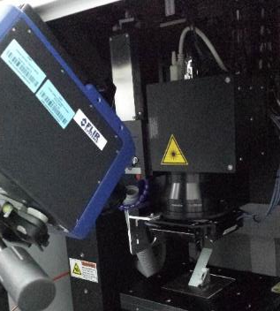
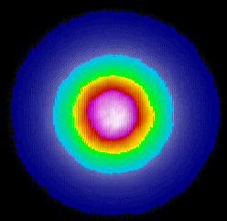


How do we reduce heat accumulation?
Laser
Thermal camera
FR4 sample
Temperature data collection and analysis courtesy of SIMTech
Notes:
Thermal camera recorded the temperature on the surface of the FR4 without soldermask, at the laser cut site. The very high temperature of the plasma was ignored, and the temperature of the location directly just beside the cut was recorded. With 74 msec of delay between passes, temperature rise was suppressed to below150 degC as compared to beyond 250 degC in the case of no delay.

Slide 19
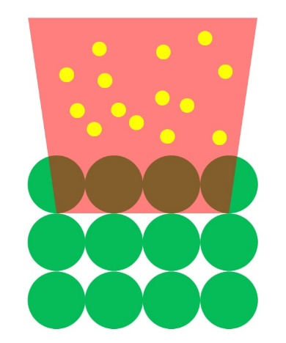

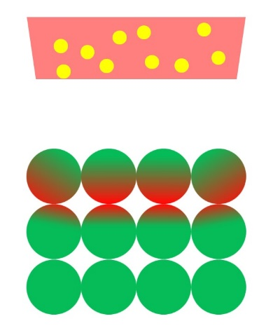
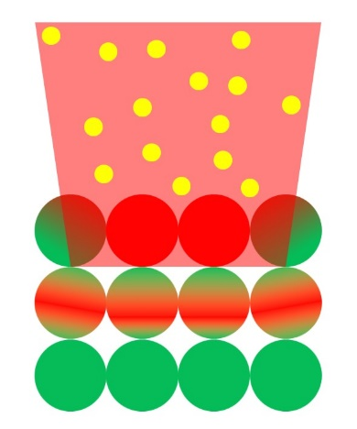
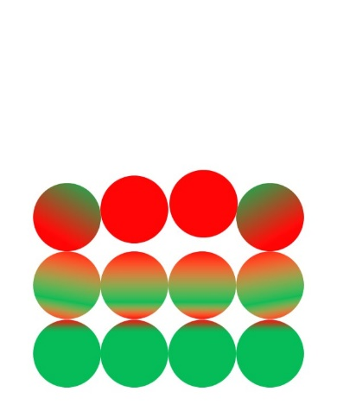
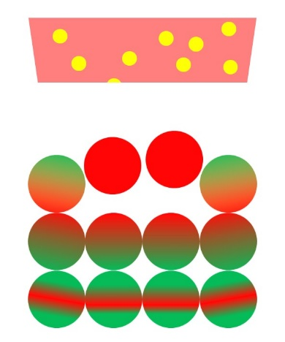
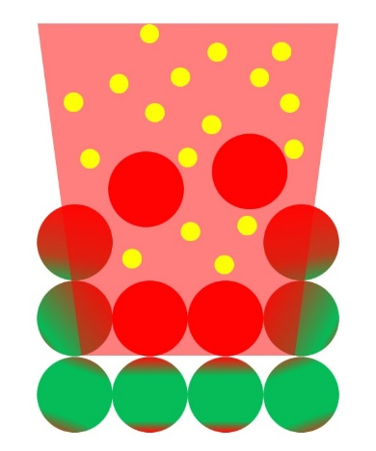
Reduce the laser-material interaction time – 1
Short-pulse lasers allow ‘thermal relaxation’ time between laser pulses
Nanosecond or shorter pulse durations
1st pulse
Thermal relaxation
2nd pulse
Thermal relaxation
3rd pulse
Photon
Fully excited
Partially excited
Not excited
Notes:
Note that even with picosecond pulses, if repetition rates are very high, it can still contribute to heat accumulation. So balance is key, should not blindly choose picosecond laser.

Slide 20
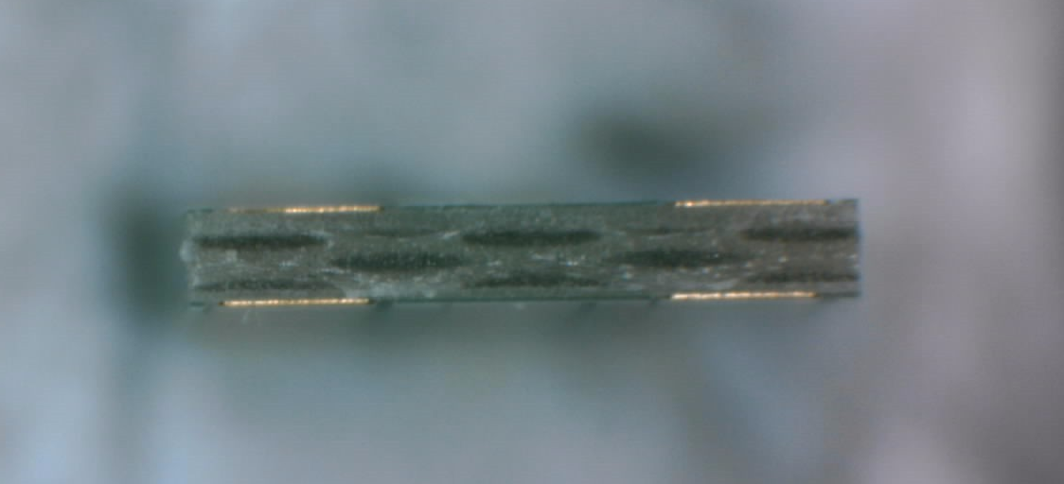
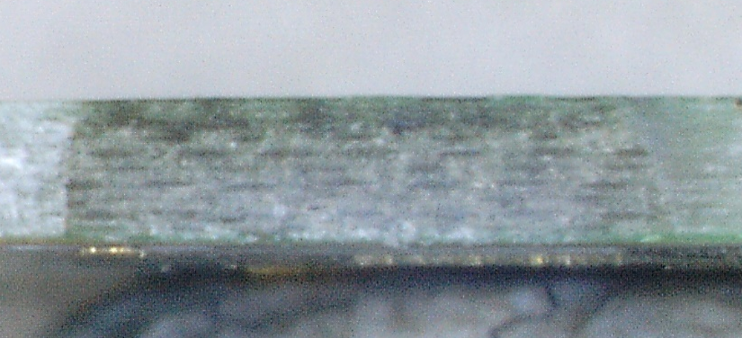
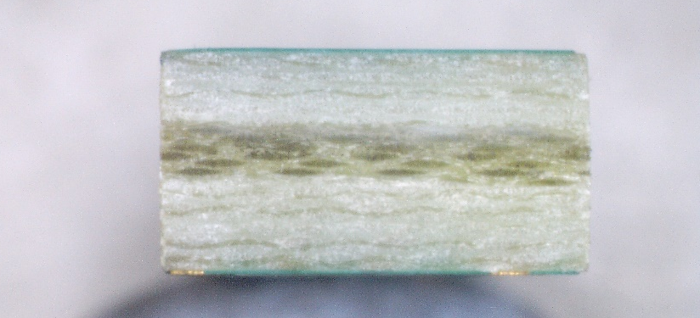
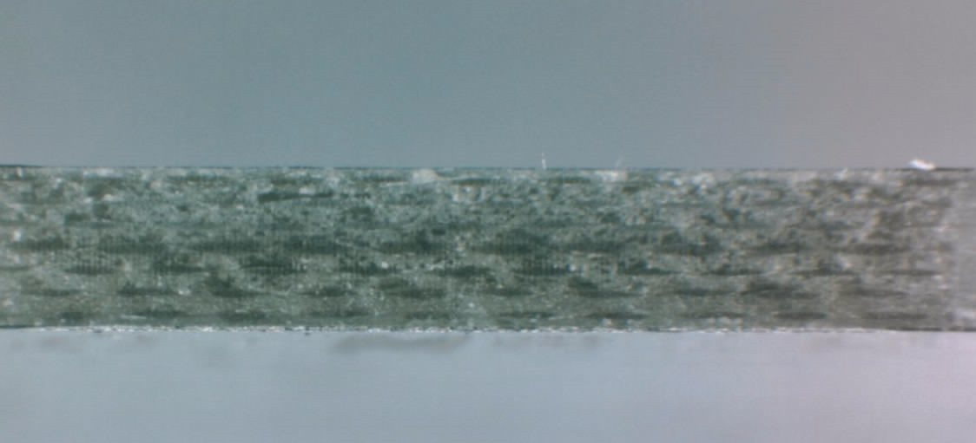
Reduce the laser-material interaction time – 2
Reduce thickness of the tabs being cut, preferably 0.6mm or less
Consider complementary V-scoring if it is thicker than 1mm
Thickness: 0.455 mm
Cut speed: 5.48 mm/s
Thickness: 0.7 mm
Cut speed: 0.94 mm/s
Thickness: 0.445 mm
Cut speed: 4.33 mm/s
Thickness: 0.75 mm
Cut speed: 0.85 mm/s
Notes:
Below 0.6mm, overall cut speed can be close to 4mm/s to 5mm/s. Beyond 0.6mm, the speed is drastically reduced to below 1mm/s.

Slide 21
Reduce the laser-material interaction time – 3
Have more tabs to cut within a cutting field, preferably 5 tabs or more
Typical field sizes: 50mm x 50mm, 100mm x 100mm
PCB panel
PCB panel
PCB panel
Laser cutting field
Laser cutting field
Laser cutting field

Slide 22
What else do I have to consider?
Is automatic pick-and-place required?
Although the laser can produce cut width smaller than 0.05mm, this amount of clearance is not conducive for automatic pick-and-place
It is preferred to have cut widths bigger than 0.1mm
Pick tool
Pick tool
Notes:
The glass fiber may sometimes melt, and resolidify as glassy state. If the parts are too close after cutting, the resolidification may join up. It is probably brittle, but it will affect auto pick-and-place because this will pull and drag the other parts

Slide 23
Common questions – 1
Why do I need a fixture to secure my PCB? I thought it is a contact-less cutting process.
Although there is no mechanical cutting force imparted by the laser, there is a natural ‘recoil’ action upon breakage. The force holding the PCBs together via the tabs is suddenly gone, therefore the PCBs and tabs may move a little after being cut through. This will affect the cutting of the subsequent tabs.
Also, a top press is usually required if the panel warpage is bad.

Slide 24
Common questions – 2
Will the process generate dust or debris?
Yes, it will. Laser cutting processes typically generate fine dust particles ranging between a few hundred microns to under a micron in diameter. PCBs, being fibre composites, will also generate debris.

Slide 25
END

